Slide 1
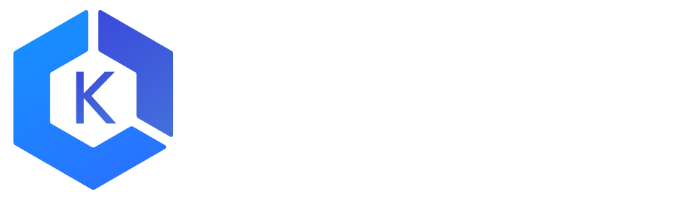
ELASTIC CONTAINER SERVICE FOR KUBERNETES
(EKS)
Notes:
We listened, and that’s why we’ve built Elastic Container Service for Kubernetes- or EKS.
We know how important a Kubernetes service is to our customers. So we didn't build Amazon EKS haphazardly. An excellent way to communicate how we took your feedback and synthesized it into a service is by taking a look at the core tenets for EKS. These tenets anchored our decision-making for how Amazon EKS should work.

Slide 2
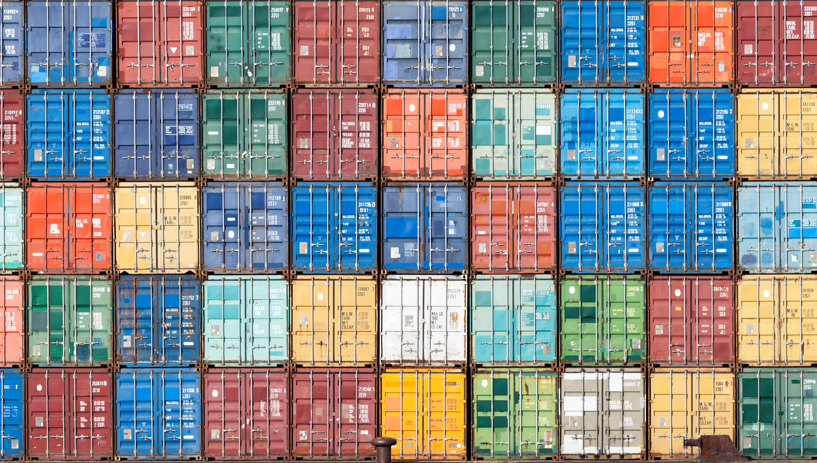

What is Kubernetes?
Open source container management platform
Helps you run containers at scale
Gives you primitives for building modern applications
Notes:
The first thing we need to do is introduce Kubernetes. Kubernetes has been around for a few years now, but it has absolutely taken the world by storm, especially over the past 12 months. It’s also rapidly gained traction amongst AWS customers.
So, strip away the hype, and at its core, Kubernetes is an open-source container management platform. It’s built to help you run your containers at scale and comes equipped with features and functions to build proper distributed applications using the 12-factor app pattern.

Slide 3
Why developers love Kubernetes A single extensible API
SCALE
PERFORMANCE
BREADTH
Notes:
And last but not least, the Kubernetes API can be thought of as a single extensible API that can be used to abstract resources both within AWS and on premise. When using Kubernetes on AWS, you can take advantage of the scale, performance, and breadth of features of the AWS platform via Kubernetes cloud integrations, and use the same familiar Kubernetes API when deploying containers on premise.

Slide 4
“Run Kubernetes for me.”
Notes:
Our customers told us, “Hey, running Kubernetes isn’t trivial work, and we think we can better spend our cycles focusing on our applications.” “if we had things our way, we wouldn’t have to think about the nuances of kubernetes deployments or configuration, we wouldn’t have to worry about managing etcd or the masters” In essence, “run Kubernetes for me”

Slide 5
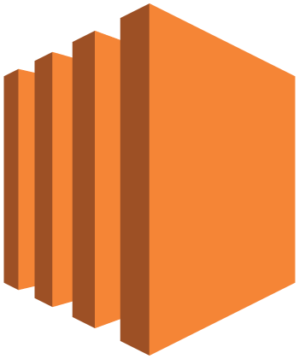


Master
Master
Master
Etcd
Etcd
Etcd
Availability
Zone 1
Availability
Zone 2
Availability
Zone 3
Notes:
You then need to run the actual worker nodes- this is where your applications run. Worker nodes are generally deployed in autoscaling groups, across multiple Azs….you can choose OD or RI instances, spot instances, whatever instance type makes sense for you...

Slide 6
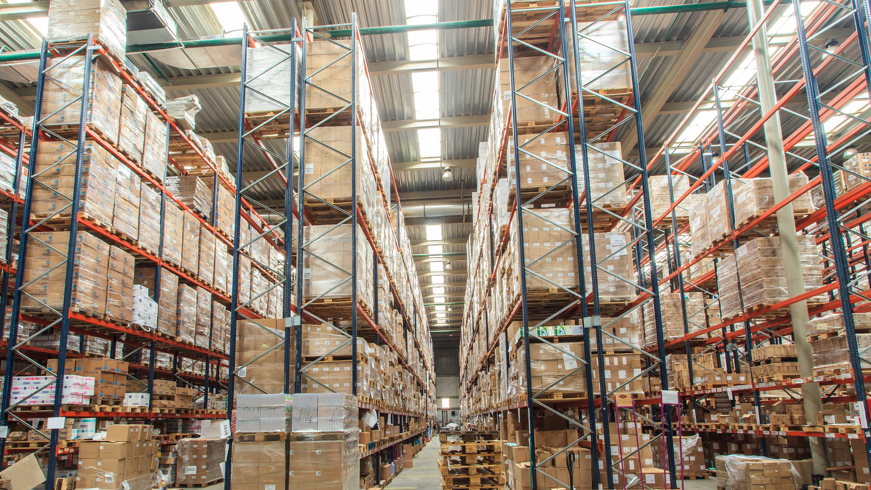
Tenet 1
EKS is a platform for enterprises to run production-grade workloads
Notes:
Tenant 1: EKS is a platform for enterprises to run production-grade workloads. Some of the largest and most innovative companies in the world are AWS customers that have given us feedback on what they need EKS to do for them.
As a result, EKS aims to provide features and management capabilities to allow enterprises to run real workloads at real scale. Reliability, visibility, scalability, and ease of management are our priorities.

Slide 7

Tenet 2
EKS provides a native and upstream Kubernetes experience
Notes:
Tenant 2: EKS provides a native and upstream Kubernetes experience. Any modifications or improvements that we make in our service must be transparent to the Kubernetes end user.
This means that your existing Kubernetes experience and know how applies directly to EKS. Your existing applications and investments in Kubernetes work right out of the box with EKS.

Slide 8

Tenet 3
If EKS customers want to use additional AWS services, the integrations are seamless and eliminate undifferentiated heavy lifting
Notes:
Tenant 3: EKS customers are not forced to use additional AWS services, but if they want to, the integrations are seamless and eliminate undifferentiated heavy lifting.
We are focused on making contributions to projects that allow customers to use the AWS components they currently know and love with their applications in Kubernetes, but at the same time, they have the freedom to choose off the shelf open source options as well.

Slide 9

IAM Authentication + Kubectl
1) Passes AWS Identity
2) Verifies AWS Identity
Kubectl
4) K8s action allowed/denied
K8s API
AWS Auth
3) Authorizes AWS Identity with RBAC
Notes:
Because we’re hosting Kubernetes as a service, we need to provide authentication on the API endpoint with IAM. IAM isn’t currently supported as a built-in authentication mechanism, so let’s dig into how this works.
1) The Authenticator assists here with step 1. When a Kubectl call is made- let’s say I’ve made a get pods call, my IAM identity is passed along with the kubernetes call. We can look in the default credential chain for my IAM ID- aws config file, IAM role, etc.
2) On the backend, Kubernetes verifies the IAM identity with AWS auth. This is purely authentication.
3) The auth response is sent back to Kubernetes, and K8s checks it’s internal RBAC mapping for authz. This determines if my original get pods call was allowed or denied.
4) The K8s API approves or denies the request.

Slide 10
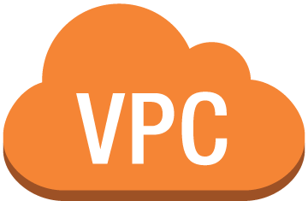


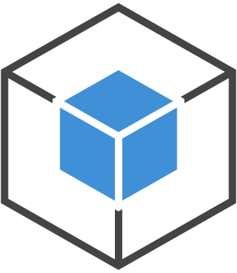

ec2.associateaddress()
ENI
Secondary IPs:
10.0.0.20
10.0.0.22
Nginx Pod
Nginx Pod
Veth IP: 10.0.0.20
Veth IP: 10.0.0.1
Secondary IPs:
10.0.0.1
10.0.0.2
Java Pod
Java Pod
Veth IP: 10.0.0.2
Veth IP: 10.0.0.22
Instance 1
ENI
Instance 2
VPC Subnet – 10.0.0.0/24
Notes:
CNI Plugin networking

Slide 11
DEMO
Notes:
Ok, so let’s switch to a quick demo. I’m going to provision a cluster and show you how easy it is to get started using EKS. <demo in console>. I also have an existing cluster available here. While that’s provisioning, let’s walk through the components and features of EKS. We’ll start with APIs.

Slide 12
Optional: Use these slides instead, to present basic Kubernetes concepts
Introduction to Kubernetes: Basic Concepts
Geremy Cohen, AWS Solutions Architect – gcohen@amazon.com

Slide 13
Agenda
Kubernetes Basics
Kubernetes Architecture
Kubernetes Cluster Creation
Q&A

Slide 14
Kubernetes (k8s) Basics

Slide 15

What is Kubernetes?
Open source container management platform
Helps you run containers at scale
Gives you objects and APIs for building modern applications

Slide 16
Kubernetes Concepts – Nodes
The machines that make up a Kubernetes cluster are called nodes.
Nodes in a Kubernetes cluster may be physical, or virtual.
There are two types of nodes:
Master-node type, which makes up the Control Plane, acts as the “brains” of the cluster.
A Worker-node type, which makes up the Data Plane, runs the actual container images (via pods.)
We’ll dive deeper into how nodes interact with each other later in the presentation.

Slide 17
Kubernetes Concepts – Objects
Kubernetes objects are entities that are used to represent the state of the cluster.
An object is a “record of intent” – once created, the cluster does its best to ensure it exists as defined. This is known as the cluster’s “desired state.”
Kubernetes is always working to make an object’s “current state” equal to the object’s “desired state.” A desired state can describe:
What pods (containers) are running, and on which nodes
IP endpoints that map to a logical group of containers
How many replicas of a container are running
And much more...
Let’s explain these k8s objects in a bit more detail...

Slide 18
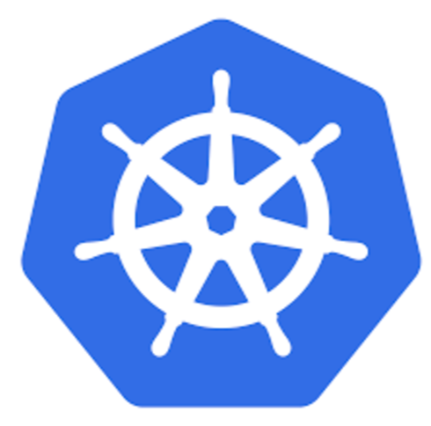
Kubernetes Objects
Pod
A thin wrapper around a container
DaemonSet
Implements a single instance of a pod on a worker node
Deployment
Details how to roll out (or roll back) across versions
Notes:
Master Node - Master nodes (physical or a VM) make up the cluster’s control plane. The Master detects and takes actions on cluster and administrator-sourced events.
Worker Node - A worker node (which can also be physical or a VM) can run pods (containers), and managed by the master node.
Kubectl - Command line interface for running commands against the K8S API (through the master).
Pods - A Pod is the smallest deployable unit that can be created, scheduled, and managed. It wraps your deployed containers with additional Kubernetes cluster-supporting control logic.
DaemonSet - A DaemonSet object ensures that all worker nodes run a single copy of a Pod – this is useful for monitoring containers, metrics-gathering containers, anything you just want ”one” of running.
Deployment - A Deployment object defines a “desired state” of the pods in the K8S cluster, for example, for an application, the number of instances of it, the container version, and the ability to rollout, and rollback between them.
ReplicaSet - ReplicaSet objects are created automatically by Deployments, and ensure that a desired number of pods are always running, for both resiliency and scalability.
Job - A Job creates one or more pods and ensures that a specified number of them successfully complete. Like a ReplicaSet, but for short running jobs vs long running jobs – a thumbnail converter for a website is a good example.
Service - K8S pods are mortal, and expected to die. A service provides a constant IP address that never changes and always maps back to the associated pods, even if they restart with a different IP address.
Label - Key/Value Pairs - Used to associate pods with specific ReplicaSets, Jobs, Services, as well as used to query specific resources within your cluster by label.

Slide 19
Kubernetes Objects
ReplicaSet
Ensures a defined number of pods are always running
Job
Ensures a pod properly runs to completion
Service
Maps a fixed IP address to a logical group of pods
Label
Key/Value pairs used for association and filtering
Notes:
Pods - A Pod is the smallest deployable unit that can be created, scheduled, and managed. It wraps your deployed containers with additional Kubernetes cluster-supporting control logic.
DaemonSet - A DaemonSet object ensures that all worker nodes run a single copy of a Pod – this is useful for monitoring containers, metrics-gathering containers, anything you just want ”one” of running.
Deployment - A Deployment object defines a “desired state” of the pods in the K8S cluster, for example, for an application, the number of instances of it, the container version, and the ability to rollout, and rollback between them.
ReplicaSet - ReplicaSet objects are created automatically by Deployments, and ensure that a desired number of pods are always running, for both resiliency and scalability.
Job - A Job creates one or more pods and ensures that a specified number of them successfully complete. Like a ReplicaSet, but for short running jobs vs long running jobs – a thumbnail converter for a website is a good example.
Service - K8S pods are mortal, and expected to die. A service provides a constant IP address that never changes and always maps back to the associated pods, even if they restart with a different IP address.
Label - Key/Value Pairs - Used to associate pods with specific ReplicaSets, Jobs, Services, as well as used to query specific resources within your cluster by label.

Slide 20
Kubernetes Architecture

Slide 21
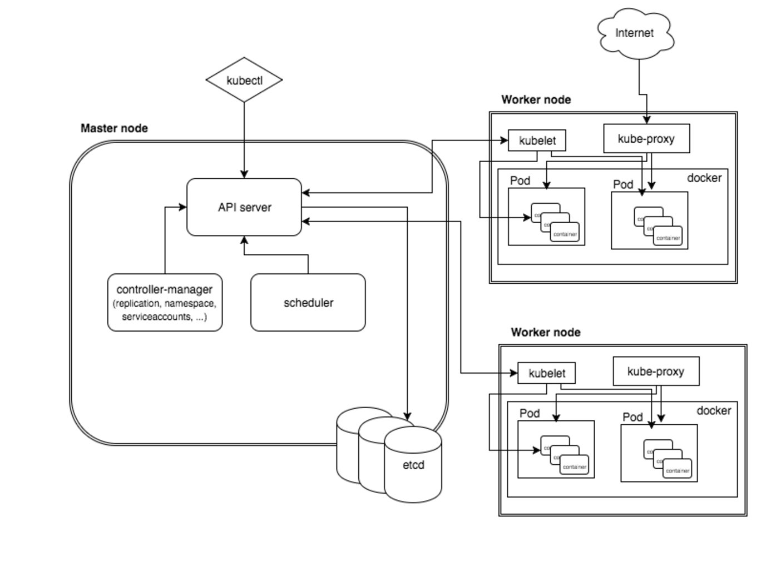
Control and Data Plane Architecture

Slide 22
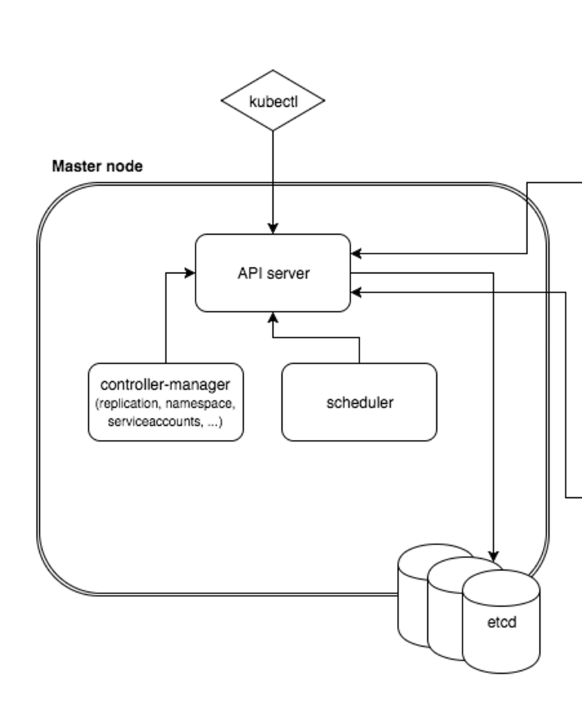
Control Plane Architecture
API Server: Entry point for REST / kubectl
etcd: Distributed key/value store
Controller-manager: Always evaluating current vs desired state
Scheduler: Schedules pods to worker nodes
Notes:
API Server: Entry point for all REST commands to control the cluster
etcd: Distributed key/value store that provides a reliable way to store data across a cluster of machines
Controller-manager: Determines when the desired state of the cluster does not match the current state
Scheduler: Decides which worker nodes to deploy pods to, based on scheduling algorithms.

Slide 23
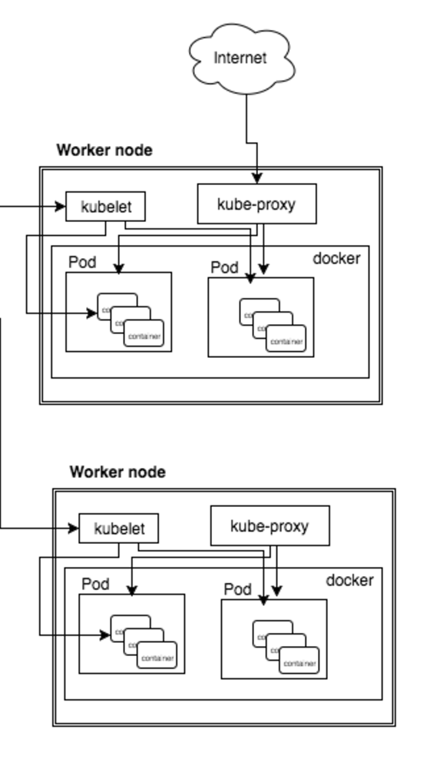
Worker Node Architecture
Kubelet: Acts as a conduit between the API server and the node
kube-proxy: Manages IP translation and routing
Notes:
Kubelet: Acts as a conduit between the API server and the node, deploys pods locally on orders of the master, and monitors local container health state.
kube-proxy: Manages IP translation and routing between the worker node, their pods, and services.

Slide 24
k8s Cluster Creation

Slide 25
Kubernetes Cluster Setup Options
In addition to the managed AWS EKS solution, there are many tools available to help bootstrap and configure a self-managed Kubernetes cluster. They include:
Minikube – Development and Learning
Kops – Learning, Development, Production
Alongside these open source solutions, there are many commercial options available as well.

Slide 26
There are a lot of solutions out there, but which one makes it the easiest to deploy, manage, and scale containerized applications using Kubernetes on AWS?
<EASY BUTTON>

